Slide 1
PST Export
M365 – MS 100

Slide 2
Topics
Understand the steps involved in PST Export.
Understand e-Discovery
Demo: How to Export PST

Slide 3
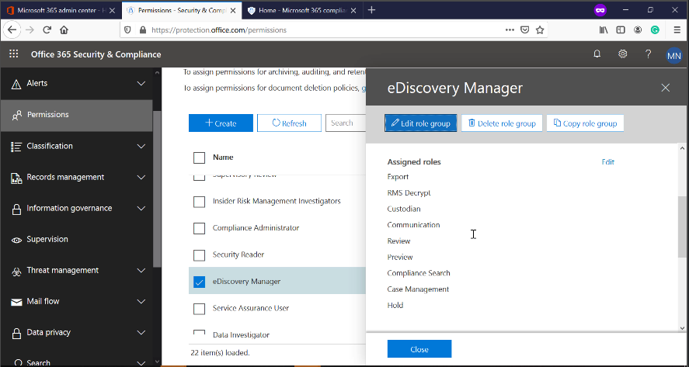
Steps : Assign roles
Assign e-discovery manager role to your admin account (permission might take even up to 24 hours to apply)
Roles Assigned: Case Management, Export, Hold, Preview, Review and RMS Decrypt.

Slide 4
Content Search
Specify the mailbox you want to export.
All location will search in the entire tenant.
Customize the location choice to Export mailbox only
Search filter:
Keywords/phrases
Time ranges
Message types
“leave all condition blank if you want to export all data”

Slide 5
Export Results
Export PST for each mailbox or ?
Don’t enable de-duplication for exchange content

Slide 6
Demo
How to Export PST using eDiscovery

Slide 7
Next Video
Export PST from Admin Center using eDiscovery
Summary
How to Import PST

